Slide 1
Car rental system
SAAD HAFEZ MOULANA 1414027
Alkharfan Ahmad 1721291
Mahanad Chamie 1625331
Ikmal Hakim bin Umar 1729299

Slide 2
Introduction
What is car rental system?
The program offers three kinds of cars
(available) – (reserved) – (rented)
Types of cars offered
(Toyota) – (Camry) – (saga) – ( Mazda)

Slide 3
2. Functions used
2.1 Log in
2.2 Main menu
2.3 Display
2.4 Update

Slide 4
2.1 Log in function
For the log in we have user name and password and in order to log in successfully the user name and password must match with the records

Slide 5
2.2 main menu function
From the main menu the user can choose between display or update.
After completing the whole program we will return to the main menu in order to ask the user wither he wants to close the program or run it again.

Slide 6
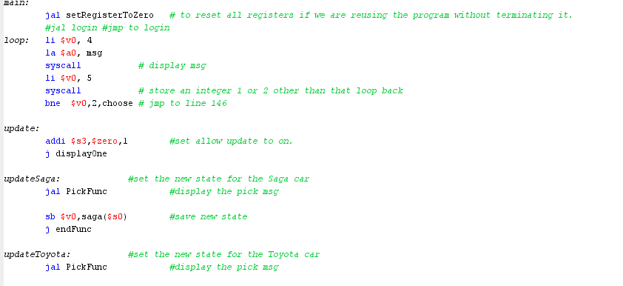
2.2 main menu function

Slide 7
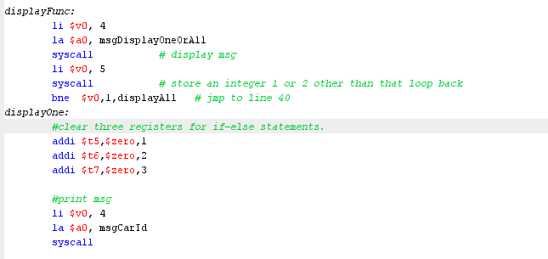
2.3 Display function
The user can choose between display one or display all.
If he chooses display all the program will display all the cars and its status.
If he chooses display one the program will ask the id of the car that he wants it to be displayed.

Slide 8
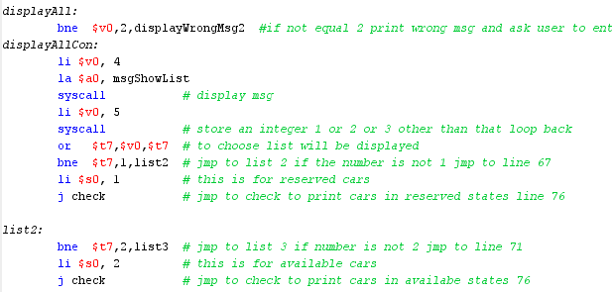
2.3 Display function
The user can choose between display one or display all.
If he chooses display all the program will display all the cars and its status.
If he chooses display one the program will ask the id of the car that he wants it to be displayed.

Slide 9
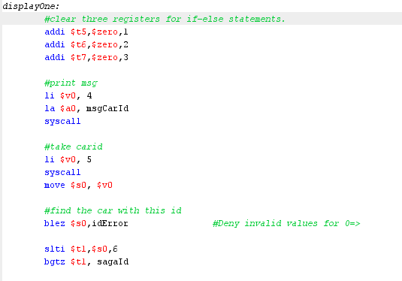
2.3 Display function
The user can choose between display one or display all.
If he chooses display all the program will display all the cars and its status.
If he chooses display one the program will ask the id of the car that he wants it to be displayed.

Slide 10
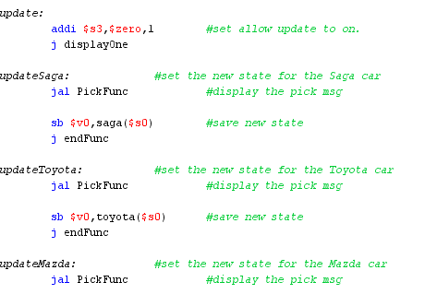
2.4 Update function
The user will be asked to enter the car id that he wants to update it.
Three status for cars and each status is assigned with a number
(available =1) , (rented = 2) , (reserved = 3)
In order to update car he has to enter the new status of the car.

Slide 11
Thank You!

